Slide 1
More JUnit CS 4501 / 6501 Software Testing

Slide 2
Common methods
review
assertTrue(boolean condition)
Assert that a condition is true
assertTrue(String message, boolean condition)
Assert that a condition is true
If the assertion is true, the string is ignored. If the assertion is not true, the string is sent to the test engineer.
assertEquals(Object expected, Object actual)
Assert that two objects are equal
fail(String message)
If a certain situation is expected when a certain section of code is reached, the string is sent to the test engineer.
Often used to test exceptional behavior

Slide 3
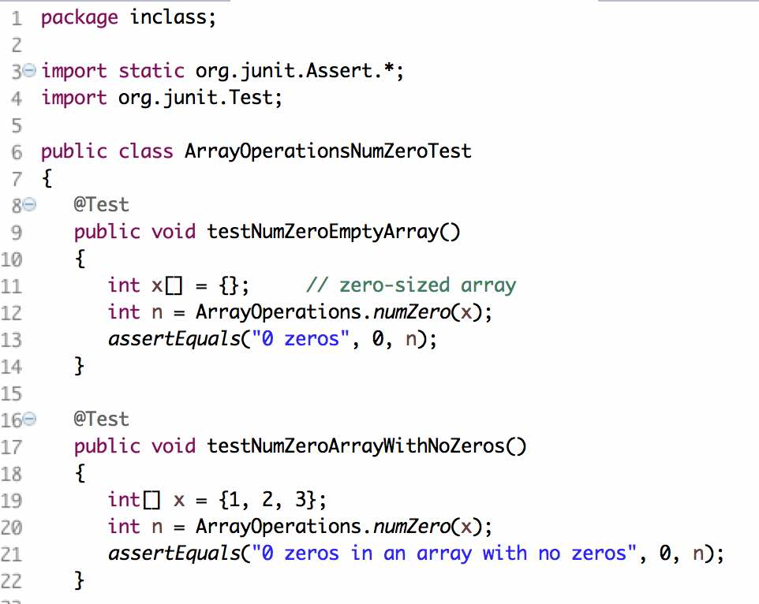
JUnit – Test Classes
review
Imports
Test class
Test
method
Another
test
method

Slide 4
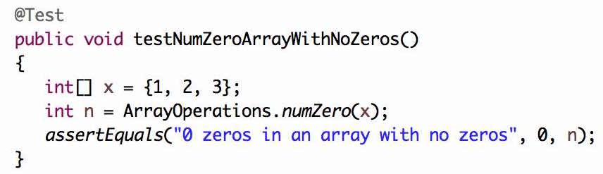
JUnit – Test Methods
review
1) Setup test case values
2) Execute program under test
expected
3) Assert expected vs. actual test outputs
4) Printed if assert fails
actual output

Slide 5
JUnit / xUnit - Conventions
Group related test methods in a single test class
The name of test packages/classes/methods should at least transmit:
The name of the subject under test (SUT) class
TestArrayOperationsNumZero
The name of the method or feature being tested
TestArrayOperationsNumZero
The purpose of the test case
testNumZeroEmptyArray
It is common to prefix or suffix test classes with “Test” and prefix test methods with “test”

Slide 6
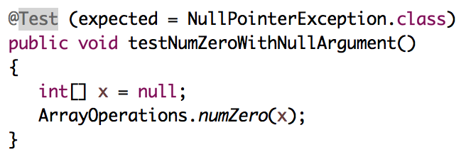
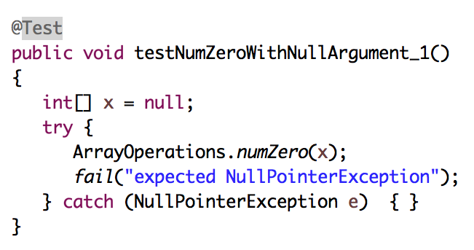
Exceptions as Expected Results
Equivalent
This pattern is more verbose and unnecessary in this case.
It is useful in situations when we wish to perform other assertions beyond the expected exception behavior

Slide 7
JUnit Test Fixtures
A test fixture is the state of the test
Objects and variables that are used by more than one test
Initializations (prefix values)
Reset values (postfix values)
Different tests can use the objects without sharing the state
Objects used in test fixtures should be declared as instance variables
They should be initialized in a @Before method
Can be deallocated or reset in an @After method

Slide 8
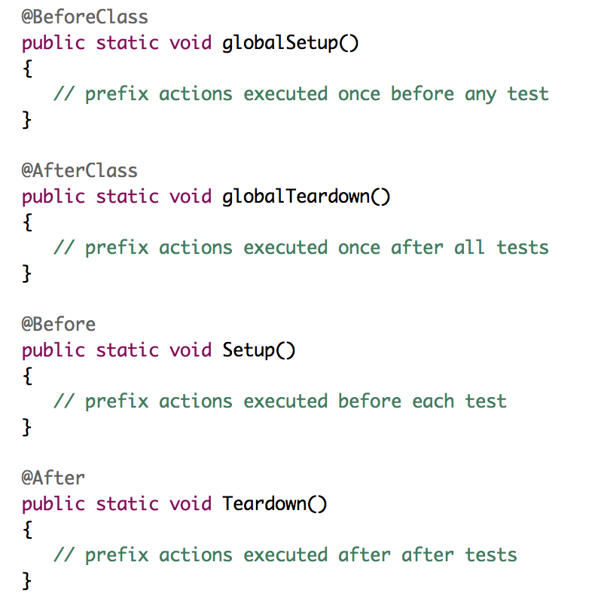
Prefix / Postfix Actions
Initialize objects and variables that are used by more than one test
Reset objects and variables that are used by more than one test

Slide 9
Data-Driven Tests
Sometimes, the same test method needs to be run multiple times, with the only difference being the input values and the expected output
Data-driven unit tests call a constructor for each collection of test values
Same tests are then run each set of data values
JUnit Parameterized mechanism implements data-driven testing
Collection of data values defined by method tagged with @Parameters annotation

Slide 10
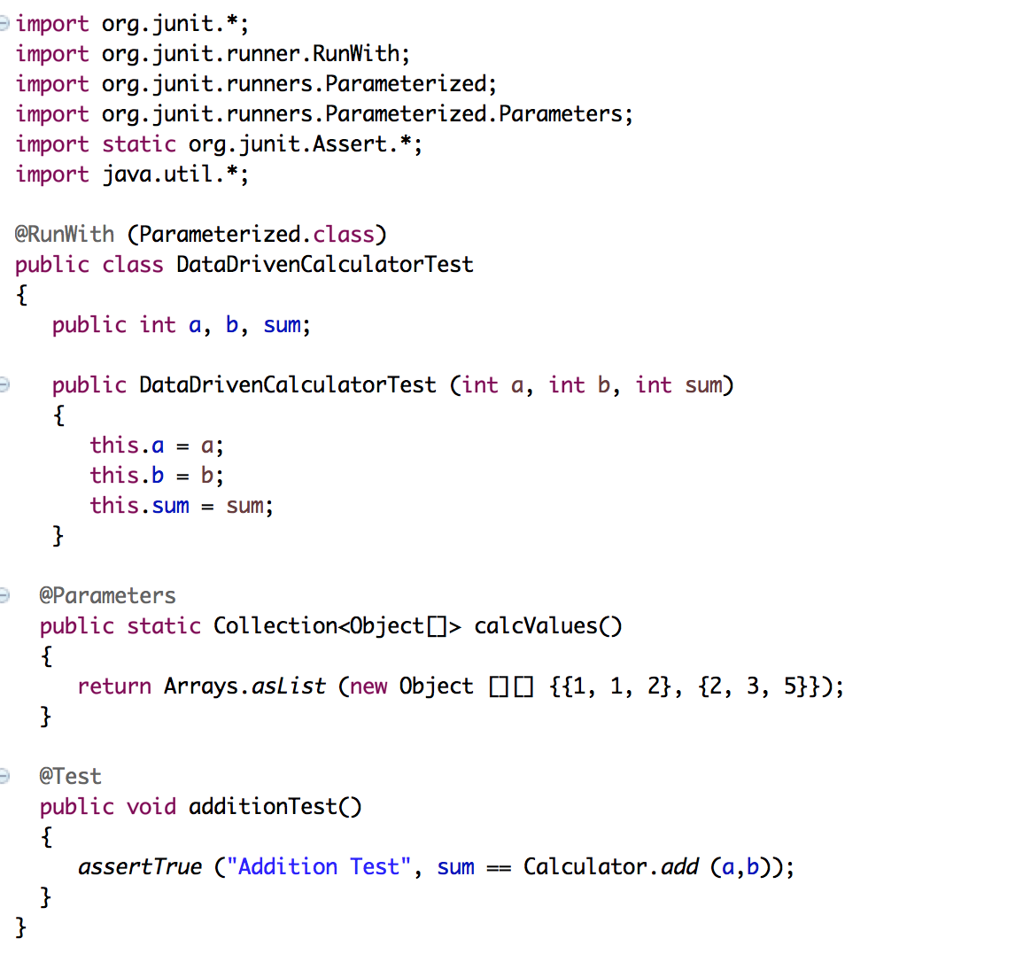
Example: JUnit Data-Driven Unit Test
Necessary
import
Returns a collection with 2 arrays of inputs and expected outputs
(thus, call the constructor twice)
Data-driven test
Constructor is called for
each triple of values
Test 1
Test values: 1, 1
Expected: 2
Test 2
Test values: 2, 3
Expected: 5
Test method uses the instance variables initialized in the constructor call

Slide 11
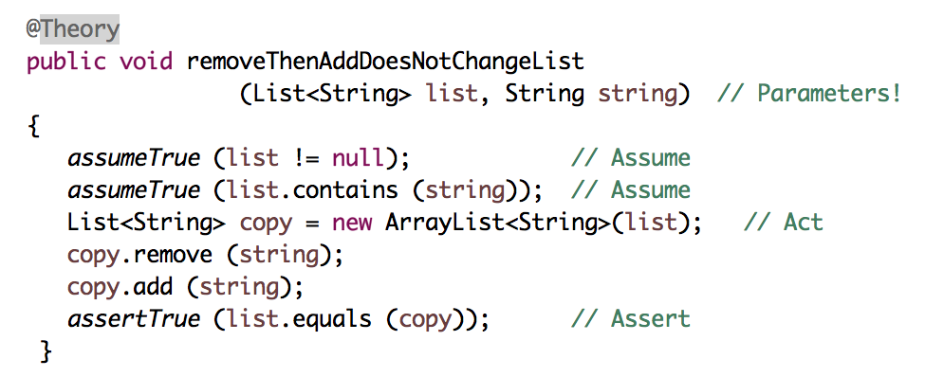
JUnit Theories
Unit tests can have actual parameters
So far, we have only seen parameterless test methods
Contract model: Assume, Act, Assert
Assumptions (preconditions) limit values appropriately
Action performs activity under scrutiny
Assertions (postconditions) check result
Predondition: the starting set contains the necessary string
Otherwise, the theory will fail

Slide 12
JUnit Theories
Unit tests can have actual parameters
So far, we have only seen parameterless test methods
Contract model: Assume, Act, Assert
Assumptions (preconditions) limit values appropriately
Action performs activity under scrutiny
Assertions (postconditions) check result
Action: remove a string from a list and then adds the string back in

Slide 13
JUnit Theories
Unit tests can have actual parameters
So far, we have only seen parameterless test methods
Contract model: Assume, Act, Assert
Assumptions (preconditions) limit values appropriately
Action performs activity under scrutiny
Assertions (postconditions) check result
This theory is only true if the starting set already contains the string being removed
Assert: check the result

Slide 14
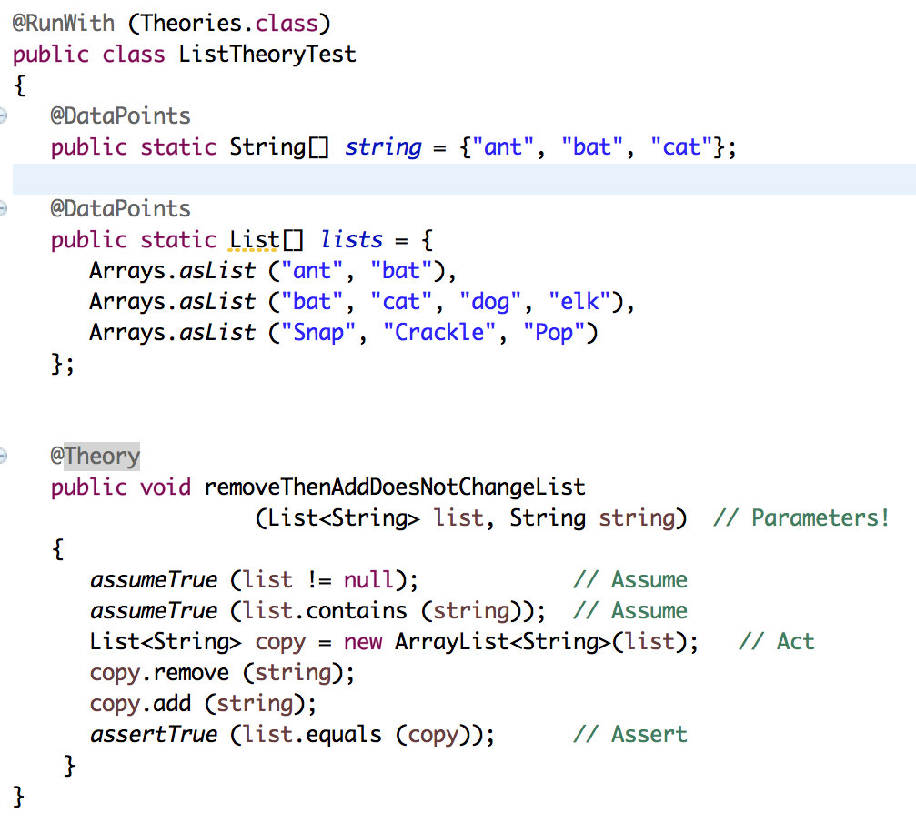
Where Do The Data Values Come From?
All combinations of values from @DataPpoints annotations where assume clause is true
@DataPoints format is an array
3 values
9 possible combinations of values
4 combinations satisfy the precondition
and also satisfy the postcondition
If a precondition is not satisfied, the postcondition does not apply
3 values

Slide 15
Summary
The only way to make testing efficient as well as effective is to automated as much as possible
Test frameworks provide very simply ways to automate out test
Data-driven testing can suffer from a combinatorial explosion in the number of tests (cross-product of the possible values for each of the parameters in the unit tests)
It is no “silver bullet” however .. It does not solve the hard problem of testing “What test values to use?”
This is test design .. The purpose of test criteria

